Slide 1
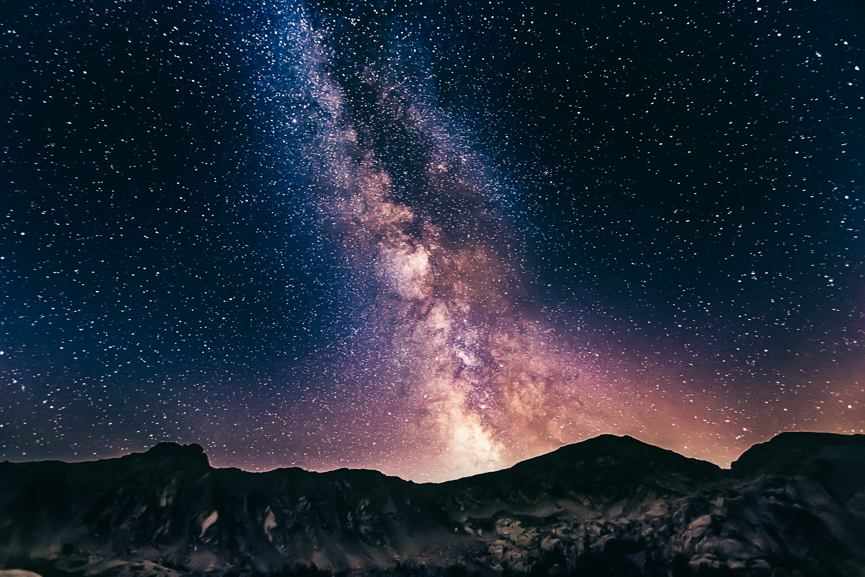
Keeping Our Dark Skies Dark

Slide 2
What am I going to learn in the next 25 minutes?
What is light pollution?
How bad is our light pollution problem?
How does light pollution effect humans, nature, and the economy?
How did we bring this on ourselves?
What can people do to maintain or improve our sky condition?

Slide 3
What is light (or luminescence) pollution?
Definition​
Brightening of night sky due to scattering of artificial light by gaseous molecules or dust particles
Result
This scattering results in a hazy, yellow-orange sky glow that is commonly seen in highly illuminated areas.​
Effects​
Sky Glow
Light Trespass
Glare
Light Clutter
… and more

Slide 4
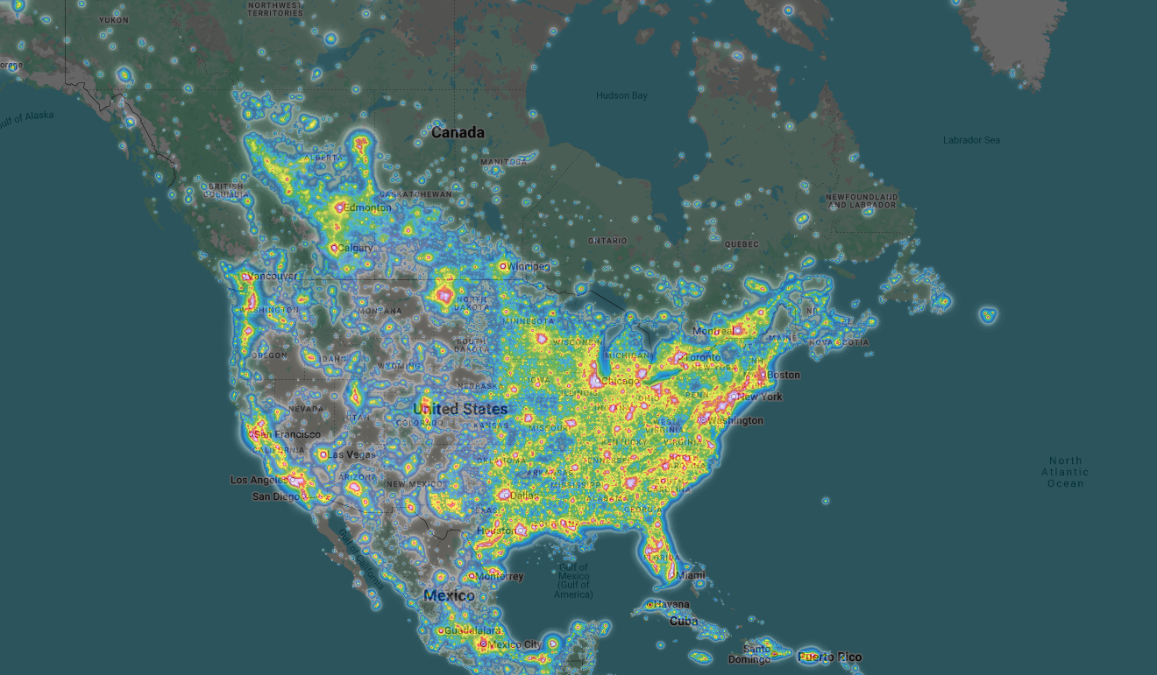
UNITED STATES LIGHT POLLUTION MAP (2024)

Slide 5
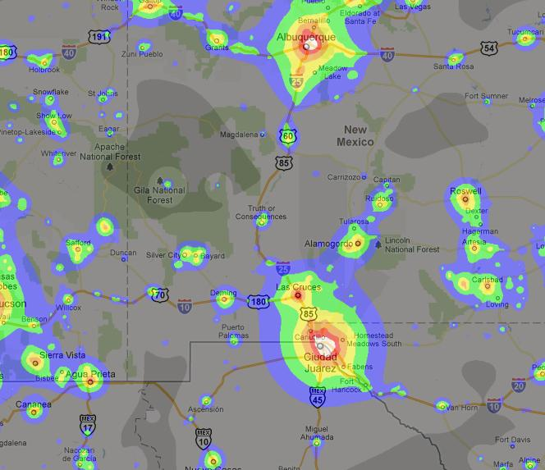
New Mexico Light Pollution Map (2023)

Slide 6
Why is Dark Important?
Human Health
Wildlife Health
Ecological Health
Economic Benefits

Slide 7
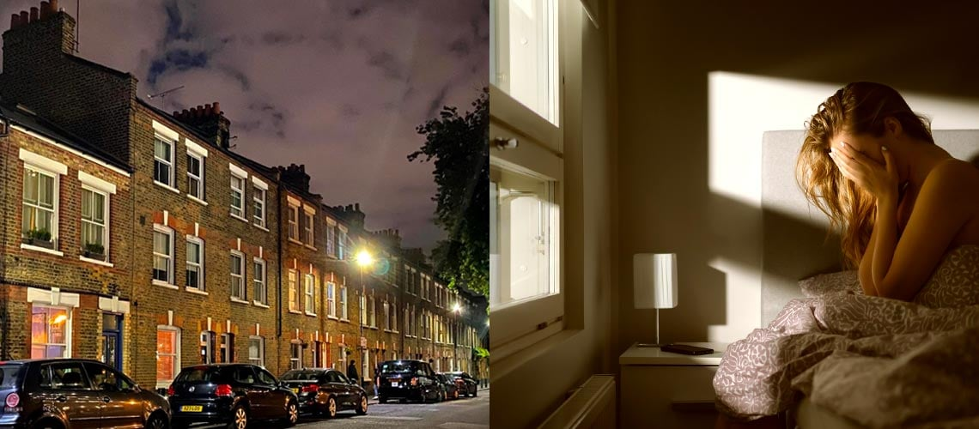

Slide 8
Inside
Humans adhere to a circadian or day/night rhythm. This cycle is largely influenced by the photoreceptors in the eye that are more sensitive to blue wave lengths of light. Humans need to experience outdoor lighting during the day and minimize the amount of artificial light entering the eye at night particularly hot or blue lighting.
Nighttime exposure to artificial light suppresses melatonin development. Besides inducing better sleep, melatonin has antioxidant properties that boost the immune system, lowers cholesterol, and helps the thyroid, pancreas, ovaries, testes, and adrenal glands function more effectively.

Slide 9
“Exposure to artificial light at night increases human risk for sleep disorders, depression, obesity, diabetes, heart disease, and certain cancers. Brighter residential nighttime lighting is associated with reduced sleep time. Reduced sleep quality, excessive sleepiness, impaired daytime functioning, and obesity.”
American Medical Association, 2016

Slide 10
Outside
Glare from poorly shielded outdoor lights decreases visual acuity by reducing contrast. It limits your ability to see dangers especially as you get older. Often outdoor lights produce more light than needed or are poorly shielded. Reducing them reduces glare, saves energy, and saves money.
“… discomfort and disability from intense, blue rich lighting can decrease visual acuity… creating driving hazards.”
American Medical Association,
Council on Science and Public Health, 2016

Slide 11
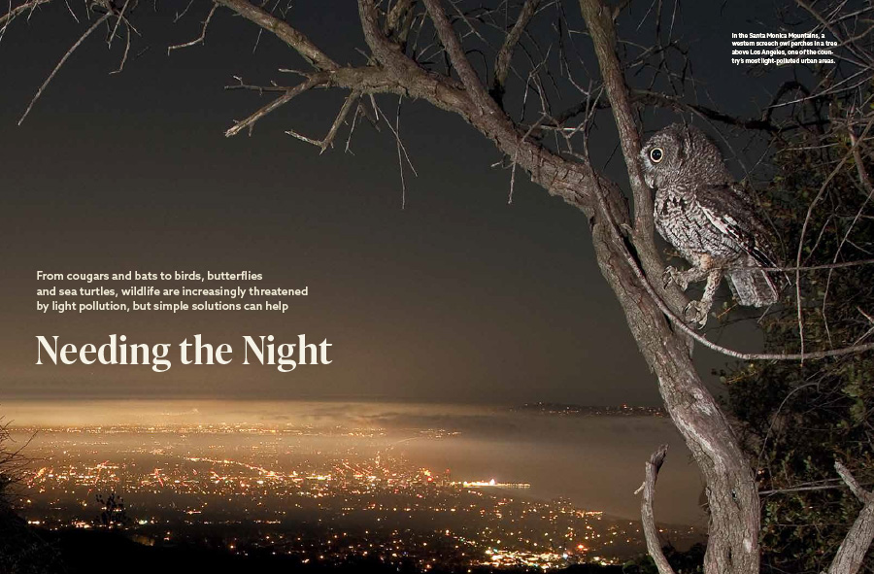

Slide 12
Birds
Lights create areas birds and bats will not enter or nest
Lights on or in nesting areas cause birds to delay their emergence at dusk when the insects they eat are most abundant
Birds circle brightly lit buildings exhausting their energy stores
Birds often collide with lighted structures
Artificial night light interferes with migrating birds ability to calibrate their internal compass

Slide 13
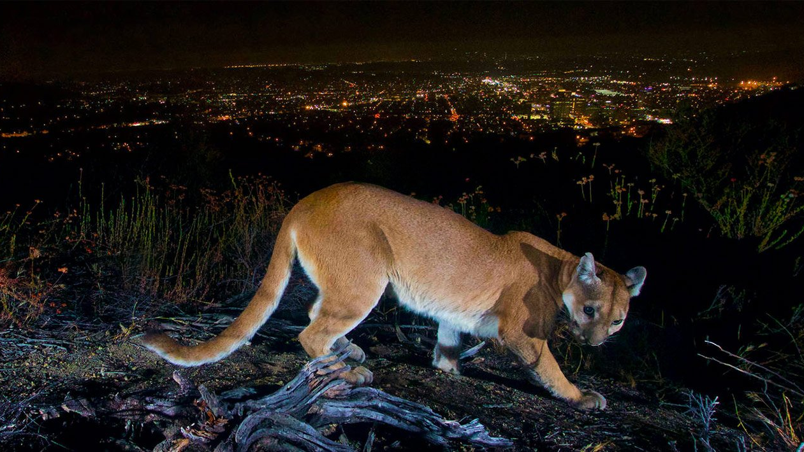

Slide 14
Larger Animals
Lights create barrier to movement, fragmenting habitats and limiting access to food and shelter
Altered light/dark cycles effect reproduction, nourishment, sleep, and protection from predatorscycles

Slide 15
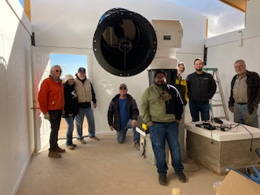
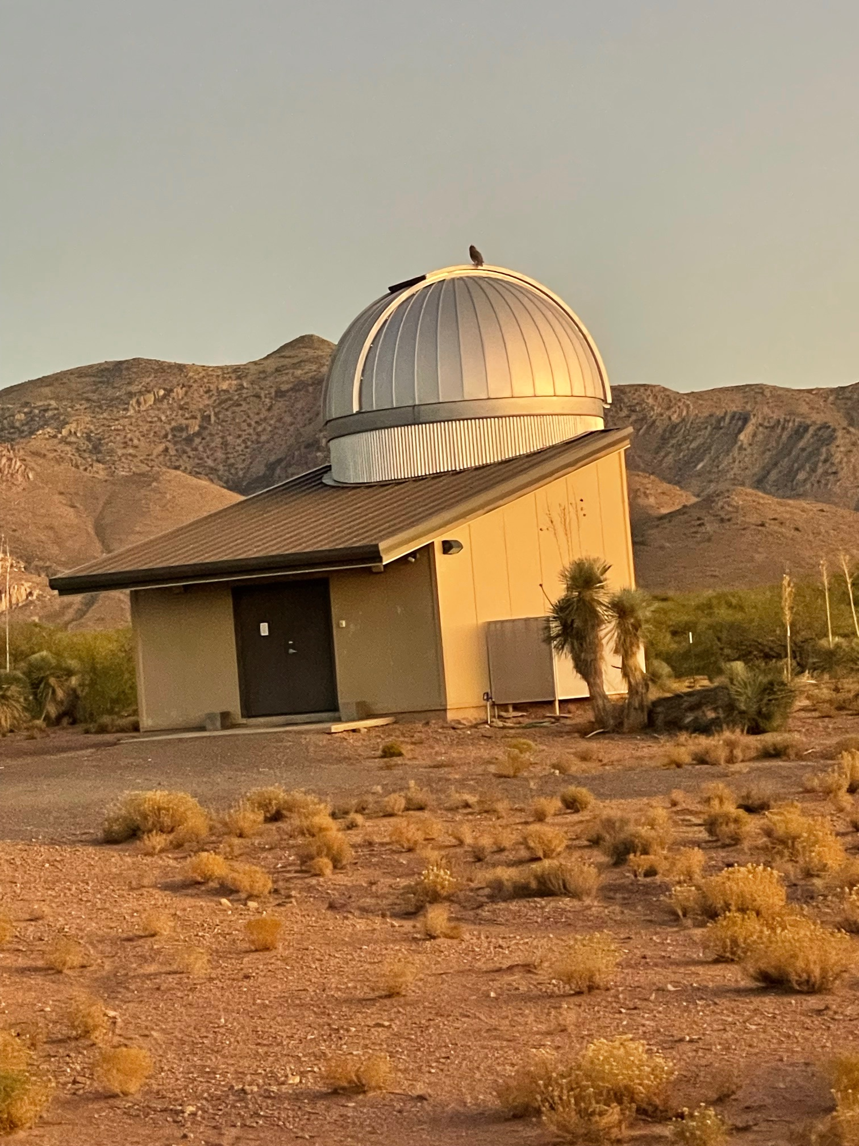
Do dark skies have an economic impact?
280-300 Telescopes Installed
80-85 Privately Owned Observatories Constructed

Slide 16
Three Remote Telescope Hosting Facilities
Providing access to Hidalgo County’s dark skies to over 100 astronomers, researchers, and scientists from throughout the world.
Astronomy Acres
Dark Sky New Mexico
Deep Sky New Mexico

Slide 17
Did we bring this predicament on ourselves?
Absolutely!
So, what do we do now? Can we undo the damage?

Slide 18
In your own personal sphere…
Get outside into natural light more often
Change your home lighting to warm bulbs with low CCT
Reduce screen time after dark; treat yourself better
Outside Your Home…
Encourage your neighbors to consider changes
Make changes where you work
Encourage local officials to implement new state standards

Slide 19
But most importantly…
When you see light pollution occuring at a business you patronize or an organization you support, bring it up with them. Be Nice!

Slide 20
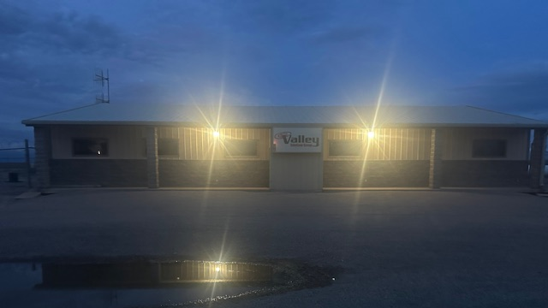

Slide 21
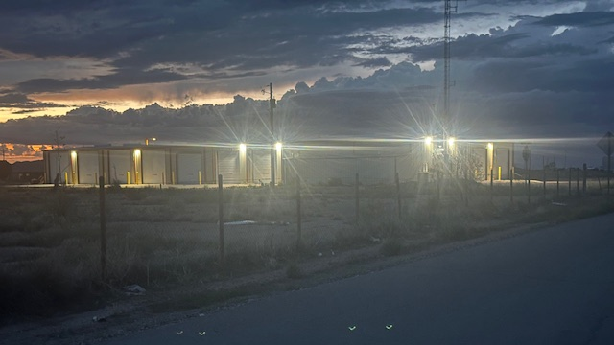

Slide 22
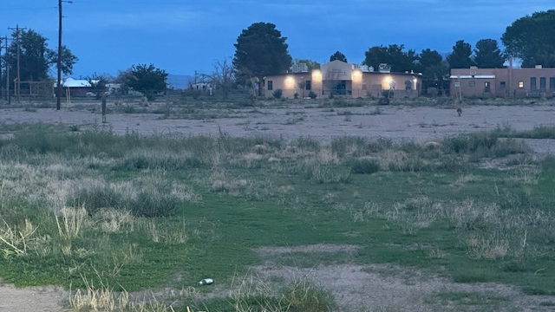

Slide 23
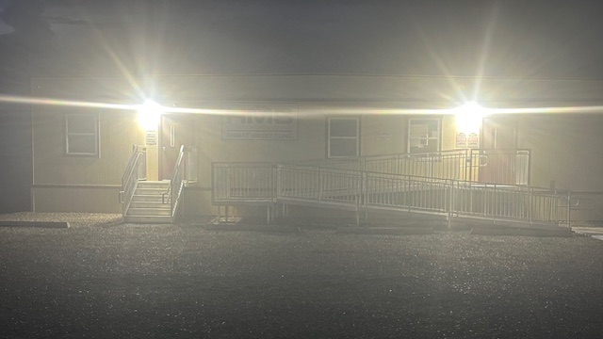

Slide 24
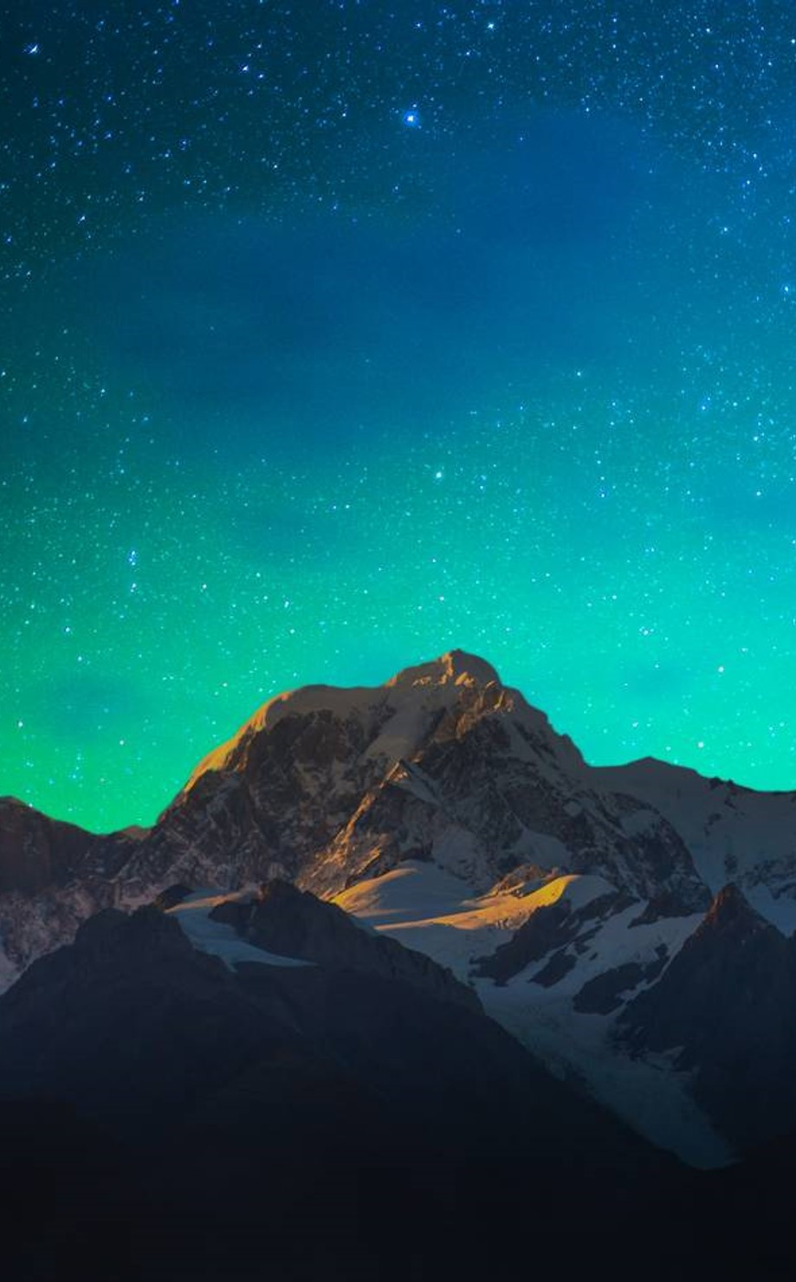
Hidalgo Dark
Mission: Maintain and improve the natural environment of our region to include maintaining our dark skies
Method: One neighbor, one business at a time
Meeting: Saturday, November 22, 6pm at Dark Sky New Mexico
Confirm your intent to attend with email to: Diana at nmhokie2@gmail.com

Slide 25
Thank you
Michael Hensley
540.819.0057
nmhokie1@gmail.com
www.darkskynewmexico.com

